Slide 1
Se group-9

Slide 2

Web-based Git or Version-control repository
Founded in February 8, 2008
By Tom Presten-Werner, Chris Wanstrath, PJ Hyett
Written using Ruby on Rails and Erlang
Largest host of source code with 20 million users and 57 million repositories

Slide 3
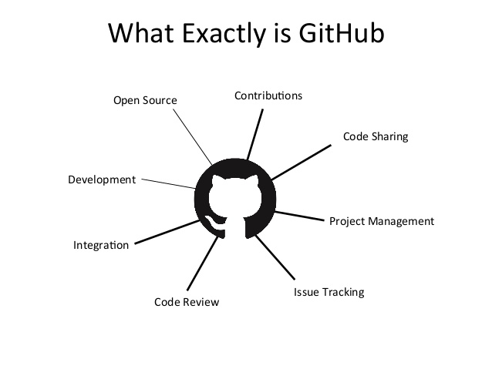
Features
Bug tracking
Feature requests
Task management

Slide 4
Private and free repositories on the same account which host open-source projects
Public
Everyone can fork and contribute your project
Can add as many collaborators as you want
And it’s FREE
Private
Only available to repository owner and the collaborators you chose to share with
Paid by month
->7$ per month for developers
->9$ per month for teams
->free for student by using free org account

Slide 5


Why git over svn?
-Centralized -Everyone has their own repository
-All changes saved in one single location -Clients can make changes which in
-Online source control repositories and those changes
will be local to them unless they
synchronize with someone else
-Offline source control

Slide 6
services
Access and manipulate projects using the standard Git command-line interface and all of the standard Git commands
Allows registered and non-registered users to browse public repositories on the site
Social-networking like functions such as feeds, followers, wikis
Social-network graph to display how developers work on their versions of a repository and what fork and branch within that fork is newest
Registered users can discuss, manage, create repositories, submit contributions to others' repositories, and review changes to code

Slide 7

Github addition formats & features
Documentation (ReadMe Files)
Issue Tracking
Pull requests
Commits History
Option to subscribe someone

Slide 8

Licensing of repositories
No need for projects hosted on its site to meet the Open-source definition
Users and developers who are to use software need to read software license in the repository

Slide 9
How to manage version?
Compression Algorithm
To make storage management better , it only stores the difference between versions

Slide 10







Designed for use by large-scale enterprise software development teams
Host their repositories behind a corporate firewall
Used By

Slide 11

Github workflow
Working directory Index(Stage) Local repository(Head) Remote repository

Slide 12
Github workflow
Clone
Working directory Index(Stage) Local repository(Head) Remote repository

Slide 13
Github workflow
add
Working directory Index(Stage) Local repository(Head) Remote repository

Slide 14
Github workflow
Commit
Working directory Index(Stage) Local repository(Head) Remote repository

Slide 15
Github workflow
Commit
Working directory Index(Stage) Local repository(Head) Remote repository

Slide 16
Github workflow
Push
Working directory Index(Stage) Local repository(Head) Remote repository

Slide 17
Github workflow
Working directory Index(Stage) Local repository(Head) Remote repository
Fetch

Slide 18
Github workflow
Working directory Index(Stage) Local repository(Head) Remote repository
Merge

Slide 19
Github workflow
Working directory Index(Stage) Local repository(Head) Remote repository
Pull

Slide 20
Github workflow
Working directory Index(Stage) Local repository(Head) Remote repository
difference HEAD

Slide 21
Github workflow
Working directory Index(Stage) Local repository(Head) Remote repository
difference

Slide 22
Thank you!!!!!!

